Slide 1
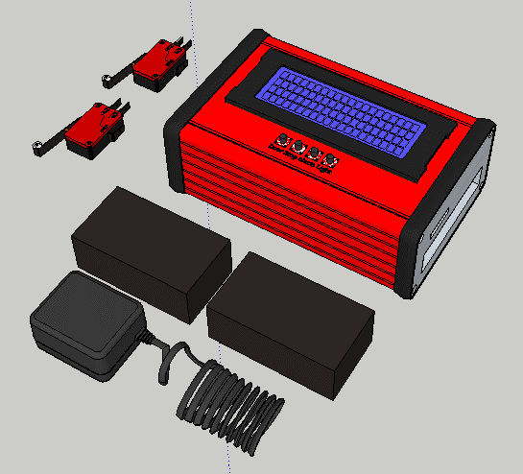
ECE554 – Final Project Open Source IoT Connected Garage Controller
Authors
Daniel Zajac
Jackson Harmer
4/8/2019
ECE554 Embedded Systems
Final Project
1

Slide 2
Agenda
Objective and Functional Description
Requirements
Design
Process
Hardware
Software
Implementation
Testing
Performance
Performance
Accomplishments
Remaining Effort
Closing Remarks
References
4/8/2019
ECE554 Embedded Systems
Final Project
2

Slide 3
Final Project Objective
Design an embedded real time system
Plan, Develop, Build and Test using waterfall development process
Develop requirements
Built on multi-tasked real-time system
Document design and software
Capture and evaluate system performance including:
Timing
Utilization
Functional
Create presentation and Report
4/8/2019
ECE554 Embedded Systems
Final Project
3

Slide 4
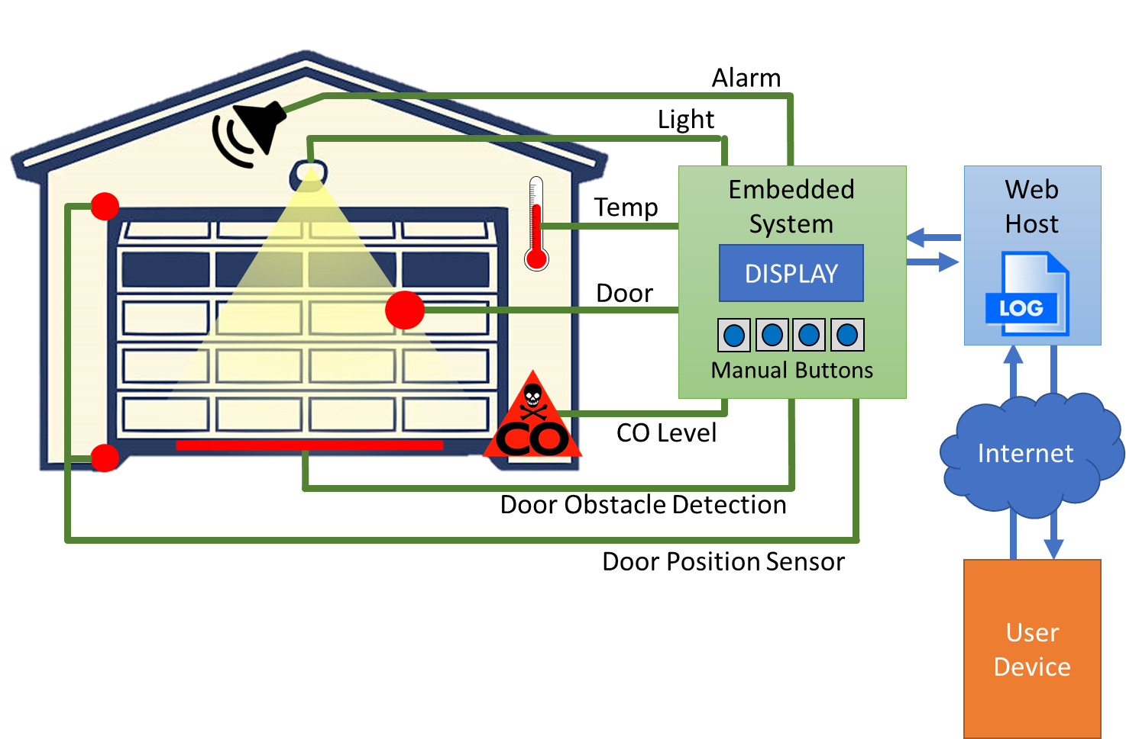
GarageRTC High Level Concept
Automation System for consumer garage
Allows owner to:
Monitor Temperature
Open/close the door
Monitor carbon monoxide (CO) levels
Turn on and off external light
Clear alarm
Connected as an IoT device
Can monitor via embedded display or web
Sensing detects obstacles in the door path
Triggers alarms if temp too high/low
Alarm if CO gets too high
Connected GarageRTC Embedded System High Level Concept
4/8/2019
ECE554 Embedded Systems
Final Project
4

Slide 5
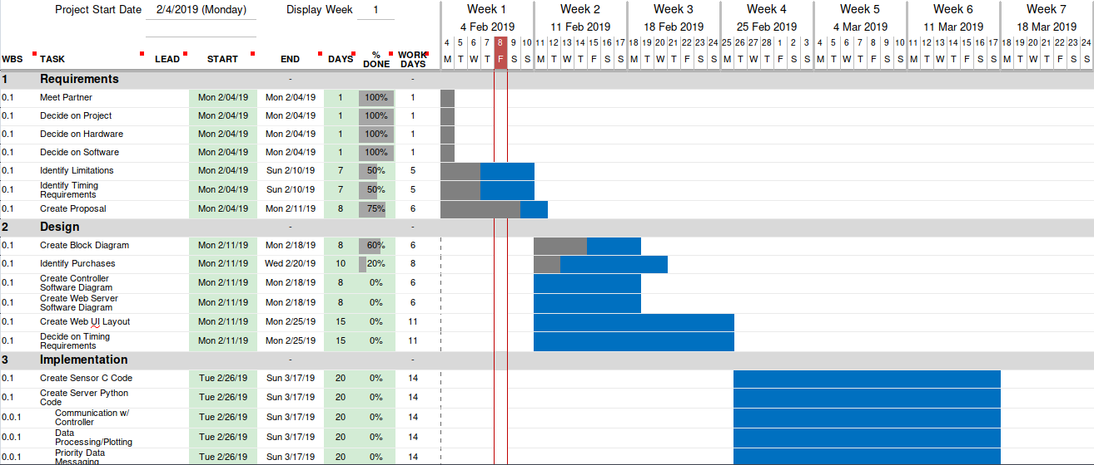
Planning
The project timeline was developed based on team availability and delivery milestones
A Gantt chart was developed to outline the major phases of project development
4/8/2019
ECE554 Embedded Systems
Final Project
5

Slide 6
Requirements From Proposal
The project proposal identified 7 Key requirements:
ECE554-REQ-001 – Manual Interface Switches
The system shall provide, at a minimum, manual interface switches for Alarm Silence, Door, Stop, and Light.
ECE554-REQ-002 – Local Display
The system shall have a digital display mounted to the main controller.
ECE554-REQ-003 – Light Control
The system shall provide the ability to digitally switch the following:
Latching switch a single mains powered LED bulb
Electrically isolated momentary switch that interfaces with the opener control
Latching switch an alarm.
ECE554-REQ-004 – Sensing Requirements
The system shall sample the following sensors:
mbient temperature of the garage
CAarbon monoxide level
Door position, at a minimum Open or Closed
Detect obstacle beneath the closing door
4/8/2019
ECE554 Embedded Systems
Final Project
6

Slide 7
Requirements From Proposal
ECE554-REQ-005 – IoT Connectivity
The system shall connect to the web server via Wifi, serial, ethernet or other suitable protocol. The system shall make available to the web server the following information:
Sensor readings
Door status
Error status
The system shall receive the following information from the server:
Door command
Light command
The system shall inform the web server upon completion or failure of any command.
ECE554-REQ-006 – Web Service
The system shall host a page that displays the information on the local display.
4/8/2019
ECE554 Embedded Systems
Final Project
7

Slide 8
Timing Requirements
ECE554-REQ-007 – Timing Requirements
The system shall meet the following timing metrics as defined in the table below:
Parameter | Timing Requirement
Local Display Update | Every 500 mS or better
Obstacle Detection | Toggle the opener control within 150 mS from sensor detection
Limit Switch Detection | Toggle the opener control within 150 mS from sensor detection
Door movement Response | Toggle the opener control within 300 mS from button press
Light Response | Latch the light control within 300 mS from button press
Post to Server interval (Idle) | Post to the server every 5000 mS
Event push to server | Post data to the server within 500 mS from the event.
Check Server for messages | Check for remote messages every 1000 mS or better
4/8/2019
ECE554 Embedded Systems
Final Project
8

Slide 9
Waterfall Design Process
Concept
Project Proposal Paper
Requirement
System Block Diagram
High Level Design
Test Procedure
Design
Daft Manual
Build HW/SW, Integrate
Implement
Unit Testing
Functional Testing
Test
Final Manual
Report
Future
Improvements
Maintenance

Slide 10
Design
High Level Design
Partitioning
Embedded Software Design
Embedded Hardware Design
Connected Software Design
4/8/2019
ECE554 Embedded Systems
Final Project
10

Slide 11
High Level Design
Reviewed functional requirements from proposal
Interface switches for Alarm Silence, Door, Stop, and Light
Digital display mounted to the main controller
Able to digitally switch mains powered LED bulb, door button, alarm
Detect temperature, Carbon monoxide, door position, obstacle beneath door
IoT connectivity to send/receive from a web server
The timing requirements and sensor input types were assessed
A block diagram of the system was constructed from the requirements
4/8/2019
ECE554 Embedded Systems
Final Project
11

Slide 12
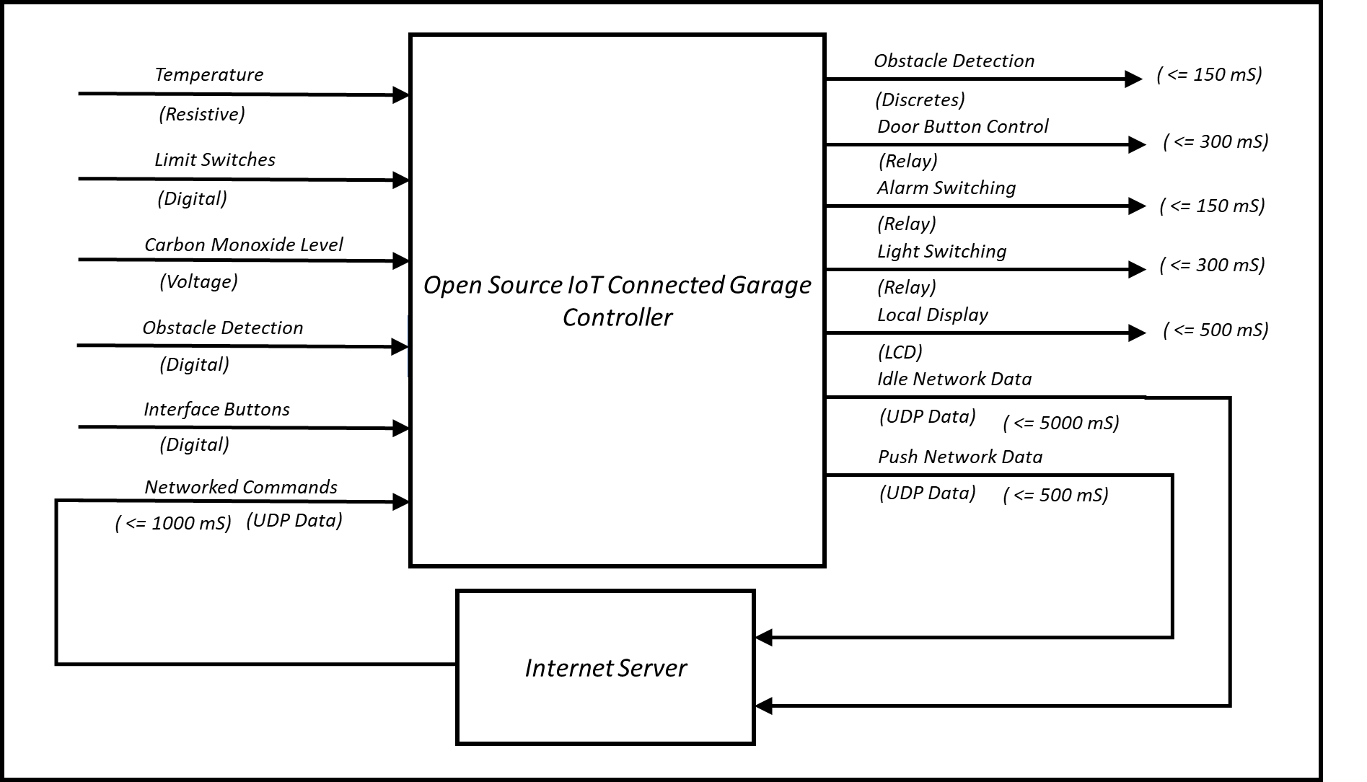
GarageRTC System Block Diagram
4/8/2019
ECE554 Embedded Systems
Final Project
12

Slide 13
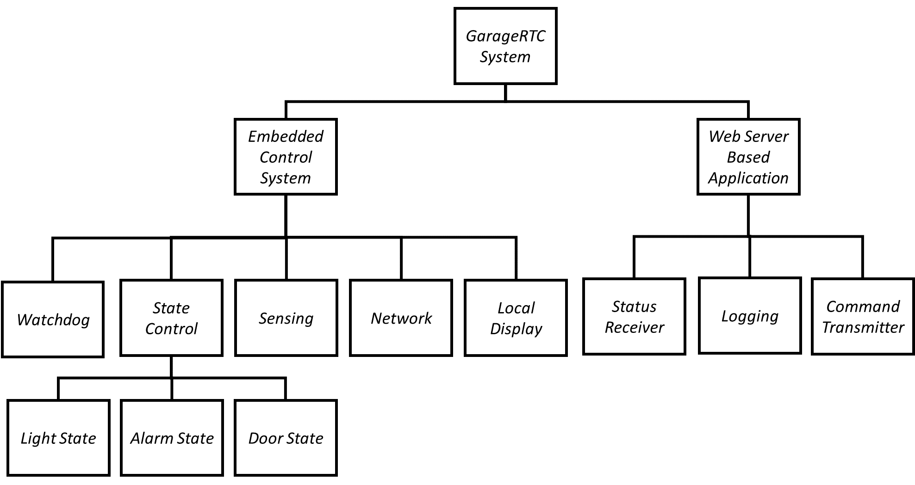
System Partitioning
The system was then partitioned
A structure chart was created
Shows logical relationships within the system
Major subsystems for embedded and web
Sub functions for each subsystem
Web subsystem
Developed in HTML, JavaScript, and Python
Will interact with controller through UDP
Defined a standard interface for messaging
Embedded subsystem
Can be developed separately in C/C++
Can produce/consume UDP Data
Will execute multiple tasks in Real Time
GarageRTC Structure Chart
4/8/2019
ECE554 Embedded Systems
Final Project
13

Slide 14
Embedded Task Decomposition
Isolated behaviors for each part of the system and assigned priorities
Sensor was oversampled to ensure each task received freshest value
Grouped behaviors into compatible tasks and assigned RTOS Priority
Behavior | Priority | Frequency | Group Task | RTOS Priority
Reading and converting sensor input | High | 100 Hz | TaskReadSensors | 3
Door Control | High | 10 Hz | TaskStateMachines | 2
Alarm Control | Medium | 10 Hz | TaskStateMachines | 2
Light Control | Low | 10 Hz | TaskStateMachines | 2
Network | Low | 1 Hz | TaskNetwork | 1
Display | Low | 2 Hz | TaskUpdateDisplay | 1
WatchDog Collection | Low | 0.7 Hz | TaskIdle | 1
4/8/2019
ECE554 Embedded Systems
Final Project
14

Slide 15
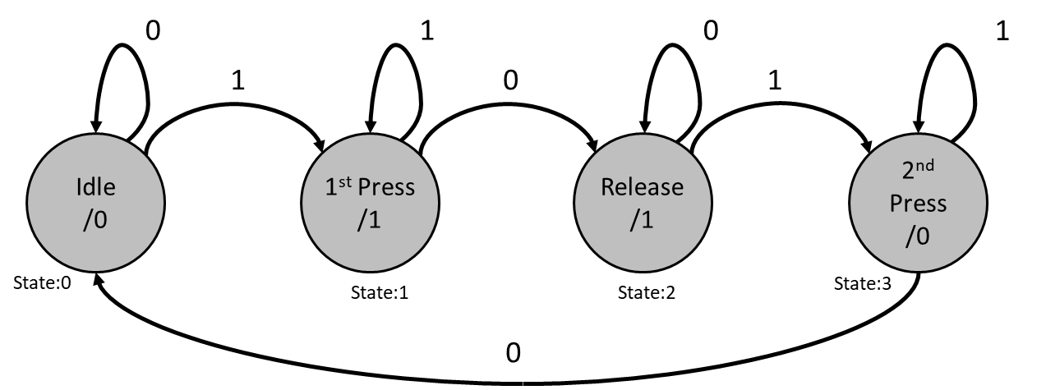
Light Toggle State Machine
Used to produce latching relay
Prevents unwanted behavior:
Relay chatter from long presses
Glitched presses resulting fast toggle
Idle – Waiting for an edge
Press – Saw an edge, keep sleeping while the button is held. Turn light on.
Release – Button released
2nd Press – Keep sleeping while button is held. Turn light off.
State machine to create latched relay behavior from button presses
4/8/2019
ECE554 Embedded Systems
Final Project
15

Slide 16
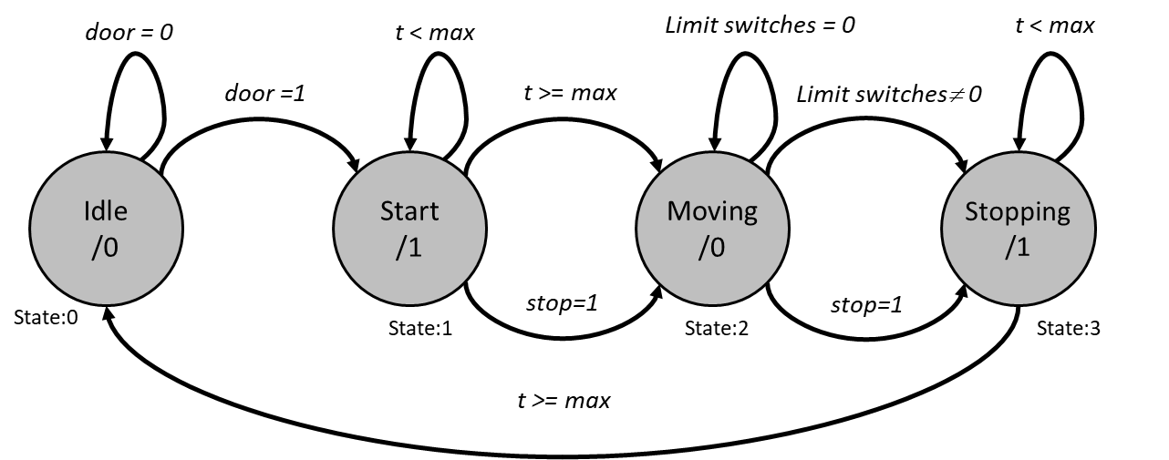
Door Control State Machine
Used to produce timed pules simulating door button presses
Idle – Waiting for a door command
Start – Saw a door command. Close the door button relay. Idle for time t or a Stop command
Moving – Door is moving, wait for a limit switch or Stop command.
Stopping – Close the door button relay for time t, stopping the door. Then return to Idle.
Door control state machine to run opener output
4/8/2019
ECE554 Embedded Systems
Final Project
16

Slide 17
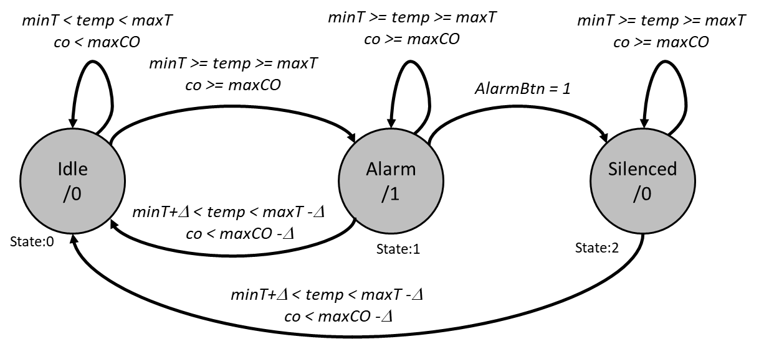
Alarm State Machine
Used for control the system alarm state
Idle – Monitor for temp and CO within limits.
Alarm – When outside limits, set the alarm state. If the value falls within limits + a hysteresis value, clear the alarm. If someone presses the Alarm silence button, silence the alarm but maintain the state.
Silenced – The alarm relay is released but the alarm state is maintained till the levels are acceptable
Alarm State Machine maintains the system Alarm State and relay.
4/8/2019
ECE554 Embedded Systems
Final Project
17

Slide 18
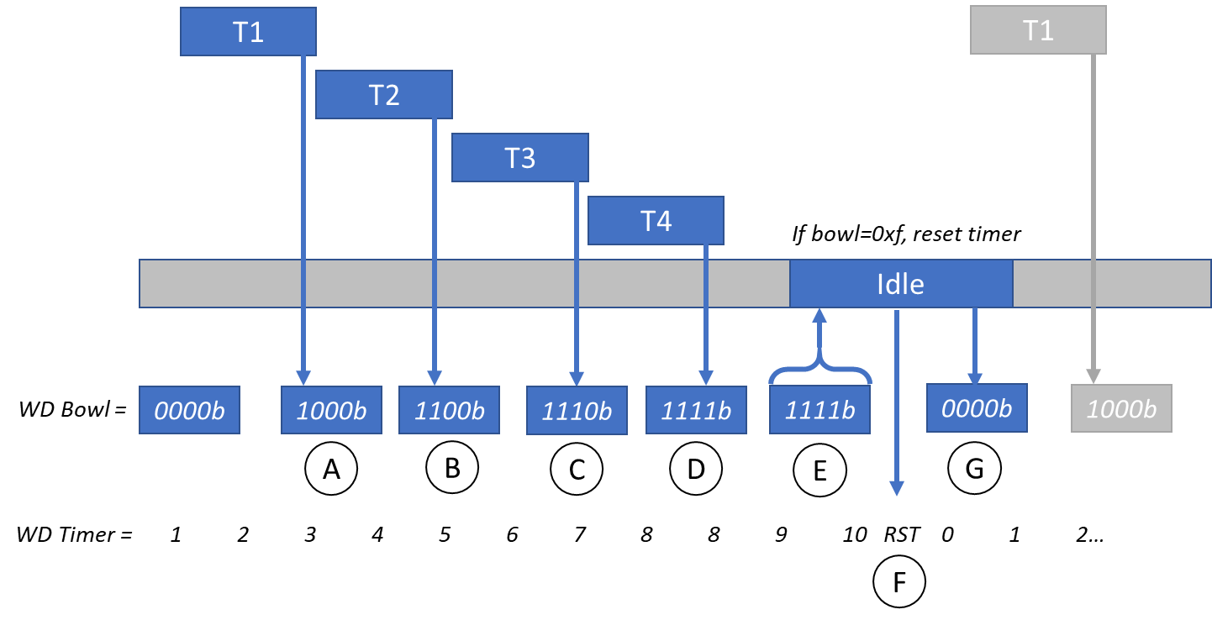
Multi-Tasked WatchDog Design
The watchdog collects bits from each running task
T1 completes, requests exclusive access to the watchdog bowl. Then writes it’s bit and releases.
B. - D. Each task takes it’s turn writing their bits into the bowl.
The WatchDog task (TaskIdle) grabs the bowl and checks for 0xF.
If all bits are in the bowl, the WD timer is reset
TaskIdle resets the bowl for the next round.
Messaging Interface between Web and Embedded System
4/8/2019
ECE554 Embedded Systems
Final Project
18

Slide 19
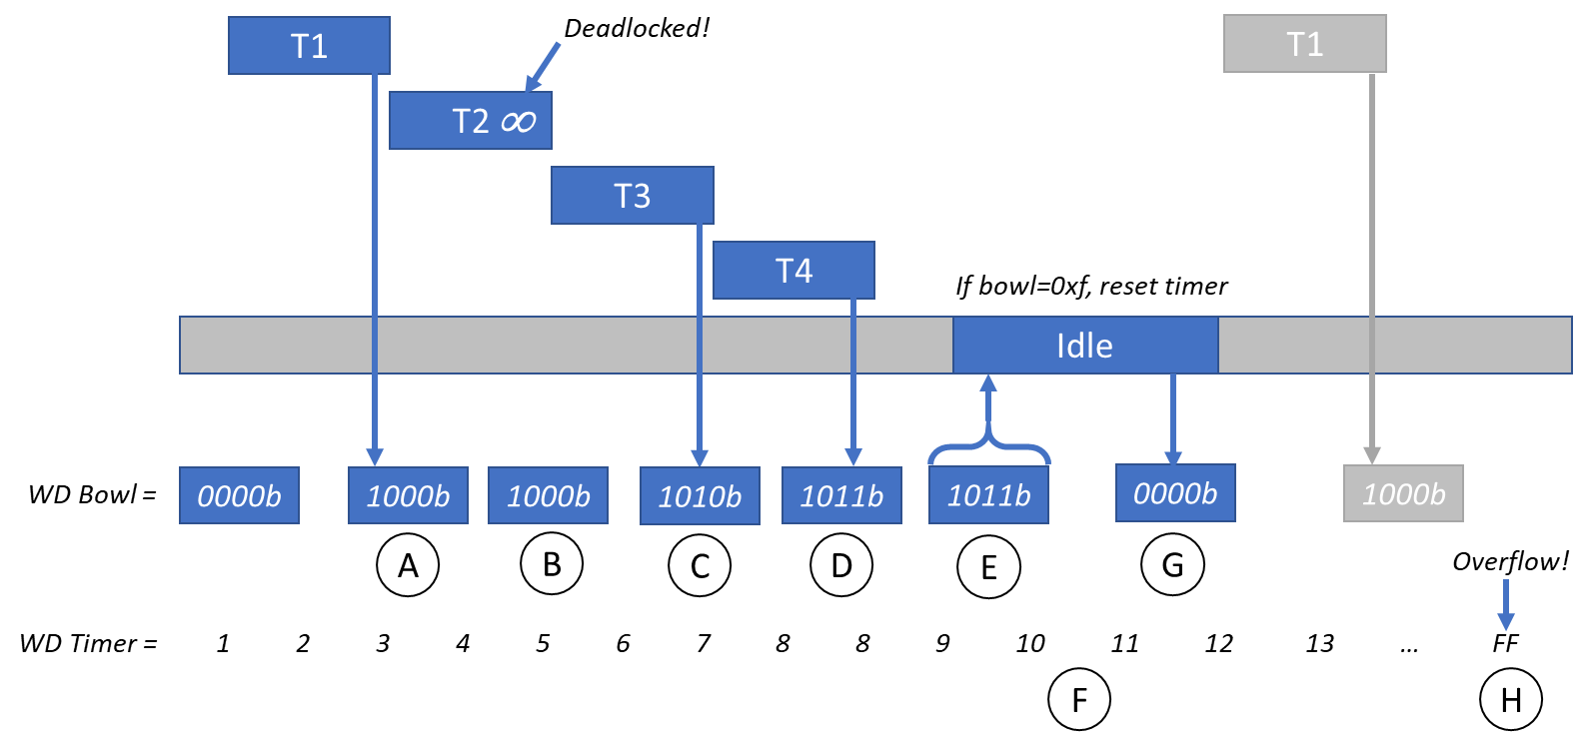
WatchDog Reset Example
In the event a process stalls
Task 1 fills the bowl
Task 2 is stalled, does not set bit
Task 3 sets bit
Task 4 sets bit
The TaskIdle fetches the bowl
Missing bit does not pet the dog
The TaskIdle clears the flags
After the Watch Dog timer exhausts, the system is reset
Can be extended to support checking deadlines
Task 2 is stalled, missing it’s write to the WatchDog Bowl eventually triggering a system reset
4/8/2019
ECE554 Embedded Systems
Final Project
19

Slide 20
Web Data Flow Diagram
Read Network Packet
Web Status Page
Process
JSON Data
Jscript
Renders Page
Web Button Presses
Store to Python
Data structure
Jscript
Raises Signal
Combine Command into Packet
Network Interface
Interval Timer
4/8/2019
ECE554 Embedded Systems
Final Project
20

Slide 21
Embedded Hardware Design
Reviewed the requirements
Selected hardware based on interface requirements
Made design decisions for aspects not identified by requirements, selected:
WiFi for communication to the web server
Laser/receiver for obstacle detection
I²C for display communication
Reed switches for up/down limit switches
Modular relay board for button, alarm, and light switching
Made software design decisions, selected:
C/C++ for the development language
Arduino IDE for development environment
FreeRTOS for RTOS support
4/8/2019
ECE554 Embedded Systems
Final Project
21

Slide 22
Embedded Hardware Design
For the system controller, an ESP32 was selected as it offers:
Native WIFI integration
Multiple cores
Incredibly fast 80 MHz+
Excellent support for peripherals
I2C LCD Drivers
UDP Server/Client capabilities
FreeRTOS support
Supports multiple IDEs (Arduino, EspressIF, Eclipse)
Good community documentation and support
Using the ESP32-NodeMCU development module, a schematic was created
4/8/2019
ECE554 Embedded Systems
Final Project
22

Slide 23
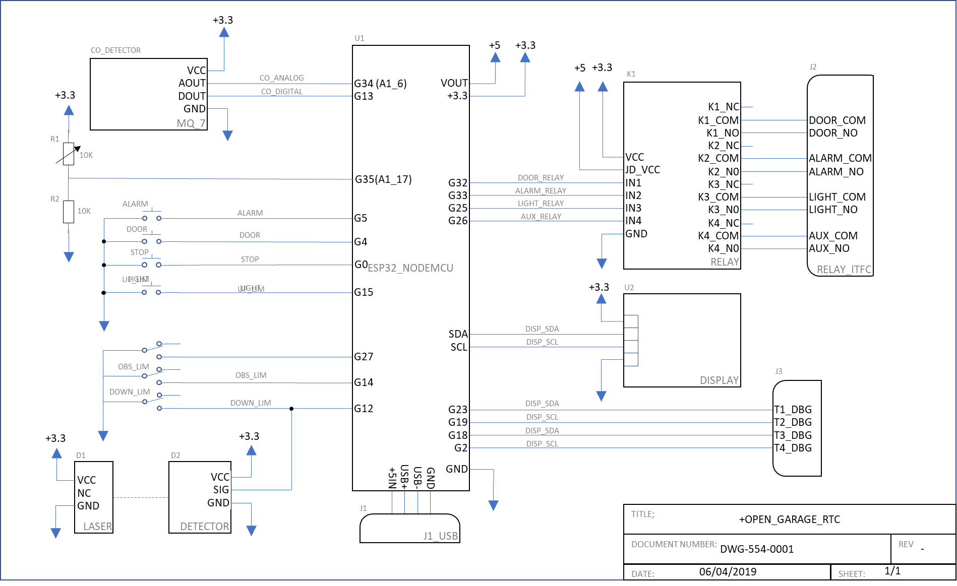
Schematic
4/8/2019
ECE554 Embedded Systems
Final Project
23

Slide 24
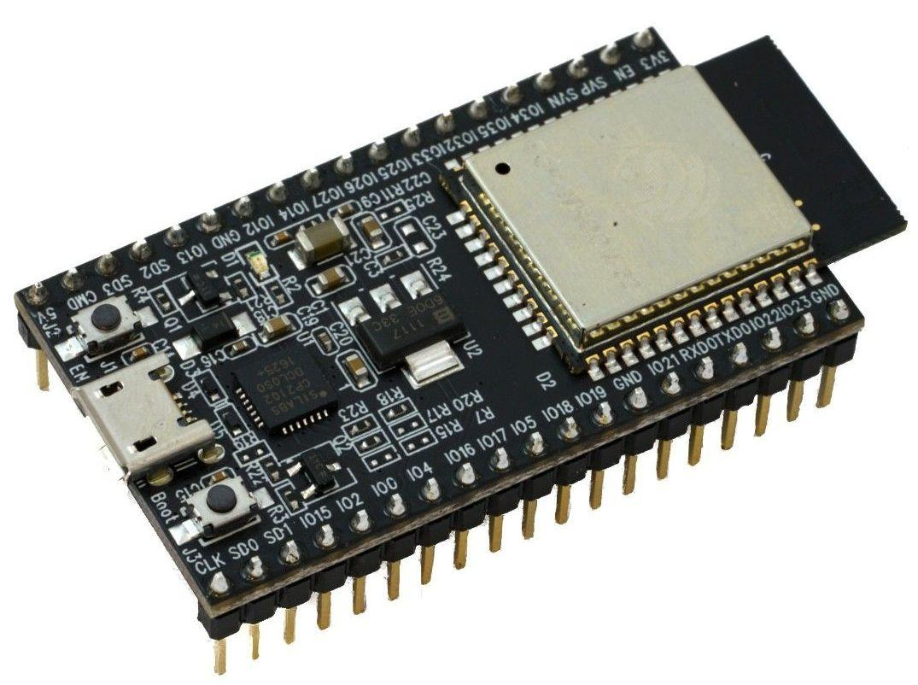
The Micro-Controller: ESP32
The ESP32 is a series of system-on-a-chip micro-controllers that utilizes the Tensilica Xtensa microprocessor
The ESP32 can be programmed in C, C++, MicroPython, or Xtensa Assembler
Most development boards also include a USB to serial interface to allow for easy re-programming and serial monitoring
Supports the use of Arduino tools and libraries
The ESP32 Micro-Controller
4/8/2019
ECE554 Embedded Systems
Final Project
24

Slide 25
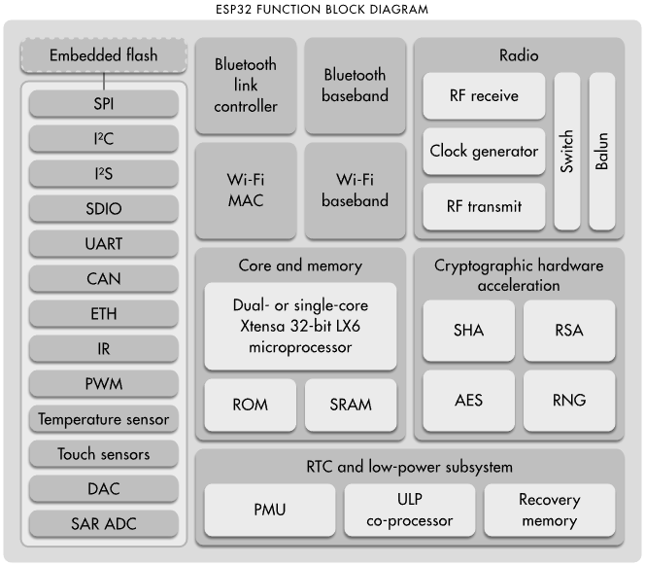
ESP32 Architecture
The ESP32’s features include:
Dual-core 32-bit processor clocked at 240 MHz
Ultra-low power co-processor (for sleep modes, interrupts)
25 Digital GPIO, 6 Analog Input, and 2 Analog Output pins
3 UART, 3 I2C, and 2 SPI devices
Cryptographic and security ASICS
4 MB of Flash, with 520 KB of SRAM
Built in 802.11n Wi-Fi and Bluetooth LE
Software, hardware, and timer interrupts
Multiple tiers of “sleep mode”
The ESP32 Micro-Controller Architecture [1]
4/8/2019
ECE554 Embedded Systems
Final Project
25

Slide 26
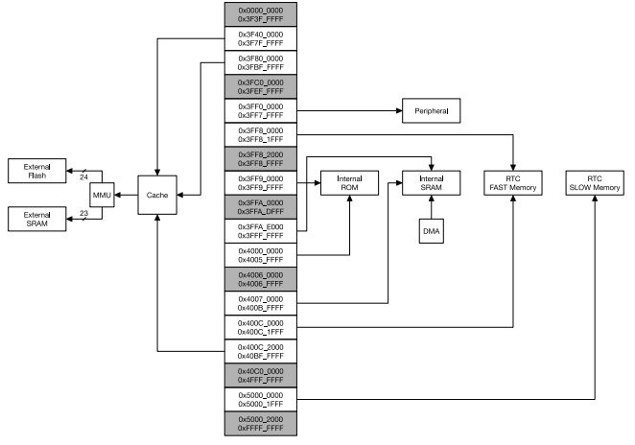
ESP32 Memory Map
The ESP32 Micro-Controller Memory Map [2]
4/8/2019
ECE554 Embedded Systems
Final Project
26

Slide 27
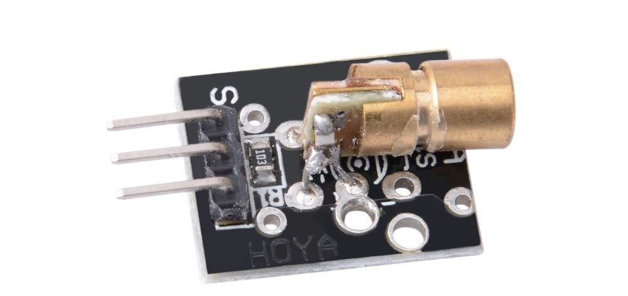
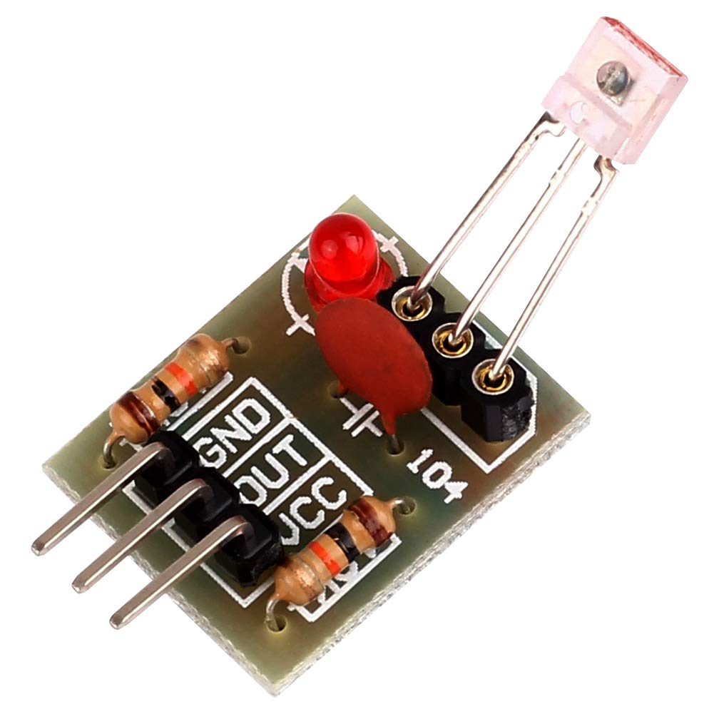
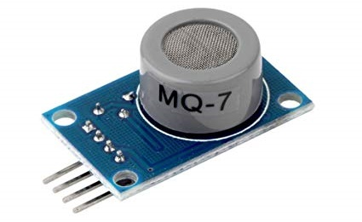
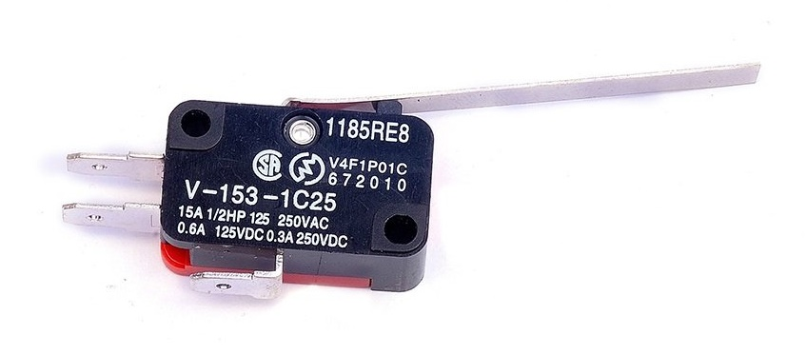
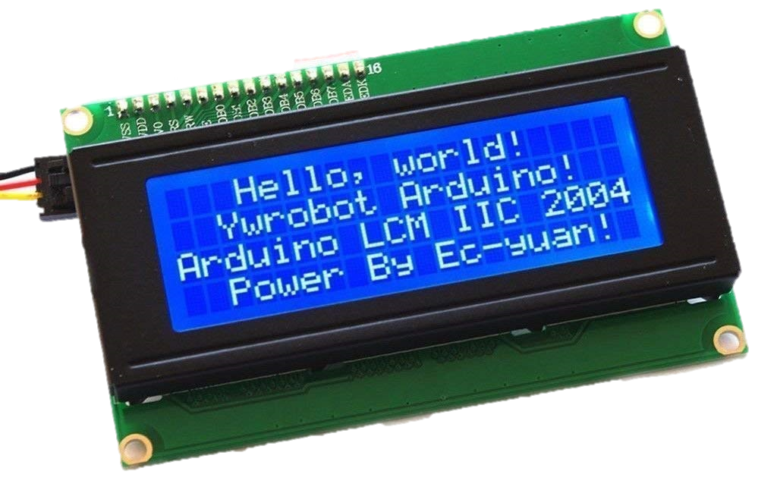
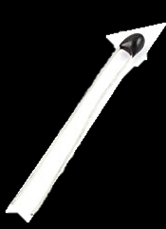
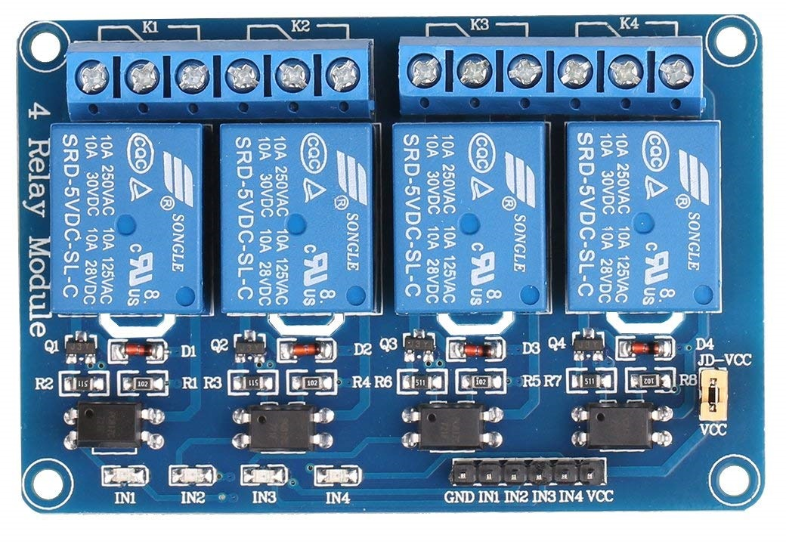
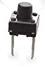
Remaining Hardware Selected
Laser diode module
Laser detector – Obstacle Detection
MQ-7 CO detector
Reed Switch – Door Limits
4x20 Character I2C Display
10K Glass bead thermistor – Temp
PCB push button – Interface switches
4x opto-isolated Relay module
A
B
C
D
E
F
G
H
Components used in construction of the embedded system
4/8/2019
ECE554 Embedded Systems
Final Project
27

Slide 28
Software and FreeRTOS
Selected for broad hardware support and native ESP32 libraries
Based on C/C++
Is a free and open source real-time OS kernel for embedded systems
Supported by many platforms and CPU architectures
Well researched scheduling and extensible for near hard real-time [4]
Provides a way for interfacing with the hardware to provide access to:
Multi-threading
Task scheduling
Mutexes, semaphores, and locks
Interrupts
Software timers
Dynamic memory allocation
4/8/2019
ECE554 Embedded Systems
Final Project
28

Slide 29
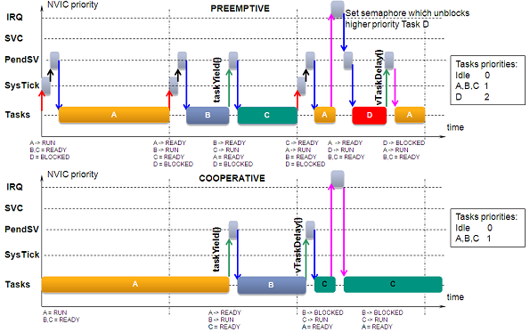
FreeRTOS Scheduling Options
By default, FreeRTOS uses a hybrid of priority-based and round-robin scheduling
The highest priority task is granted CPU time first
Equal priority tasks go into round-robin scheduling
Can be configured to use either preemptive or cooperative
Cooperative being good for low-power applications (doesn’t rely on system ticks)
Hybrid Preemptive and Cooperative scheduling [5]
4/8/2019
ECE554 Embedded Systems
Final Project
29

Slide 30
Embedded Tasks
Multiple tasks can share CPU time on both cores
Tasks include:
TaskReadSensors - Reading and converting sensor input
TaskStateMachines - Door, Alarm, and Light Control
TaskNetwork – Network receiving and sending
TaskUpdateDisplay – Update LCD Display
TaskIdle – WatchDog Collection
4/8/2019
ECE554 Embedded Systems
Final Project
30

Slide 31
Networking Tasks
Messages are periodically sent from the controller to the web server
Messages are in a JSON serialized format
Messages are sent over UDP
Messages are encrypted using private and public keys
Messages are received asynchronously from the web server
Also in JSON format, sent over UDP, and encrypted
Messages from web server are treated as high priority software interrupts
2/4/2019
ECE554 Embedded Systems
Final Project
31

Slide 32
Implementation
Hardware Implementation
Embedded Software Implementation
Networked Software Implementation
Integration
Debugging
4/8/2019
ECE554 Embedded Systems
Final Project
32

Slide 33
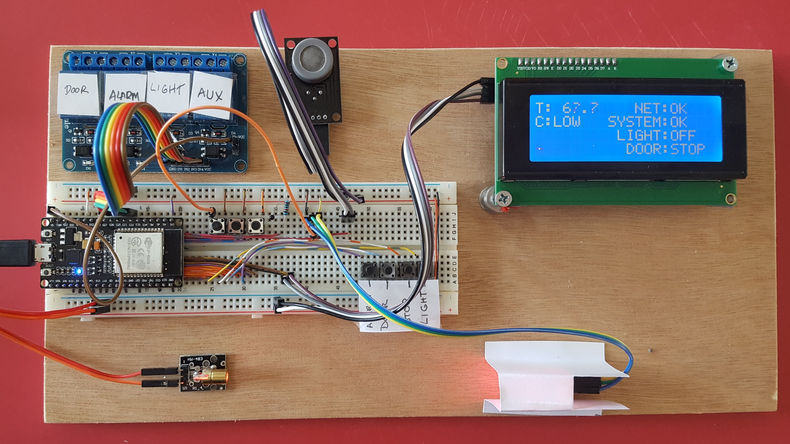
Embedded Construction
Relays
CO Detector
ESP32
Display
Interface Buttons
Optical Detector
Debug
Limit Switches
4/8/2019
ECE554 Embedded Systems
Final Project
33

Slide 34
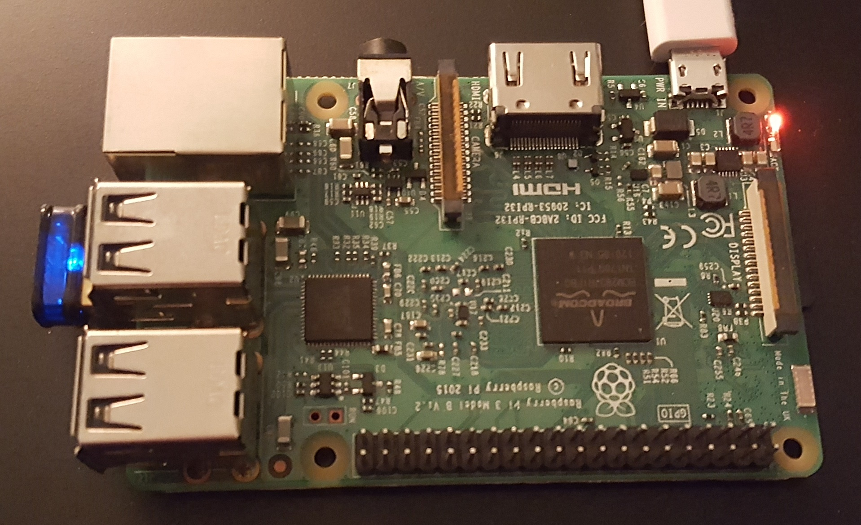
Web Server Construction
The web server hardware is non-specific
For this project, a Raspberry Pi was used
Offers compact footprint, with fast ARM processor
Runs Debian based Linux
Pi was loaded with Python and Flask
Pi communicates with controller using UDP (communication over wired protocols such as SPI, UART, or I²C is also possible)
Raspberry PI running the Server Software for this Project
4/8/2019
ECE554 Embedded Systems
Final Project
34

Slide 35
Web Server Software
The web server running on the Raspberry Pi uses the Flask web framework
Written in Python, allows for hosting small to medium web apps on low-powered devices
Serves HTML, CSS, and JavaScript using Jinja templates
Supports plugins such as WebSocket API
Allows for interaction with the host OS and hardware via Python
Supports hot reloading
WebSockets are used to allow for asynchronous programming
jQuery and JavaScript WebSocket API run on client machine and connect to Flask WebSocket API running on server
Client can issue a command to use a callback function on the server computer
This can be used to trigger events such as sending UDP messages to the controller or changing settings
4/8/2019
ECE554 Embedded Systems
Final Project
35

Slide 36
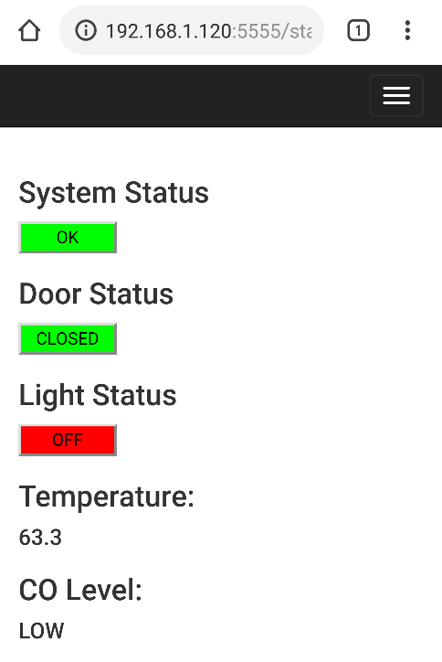
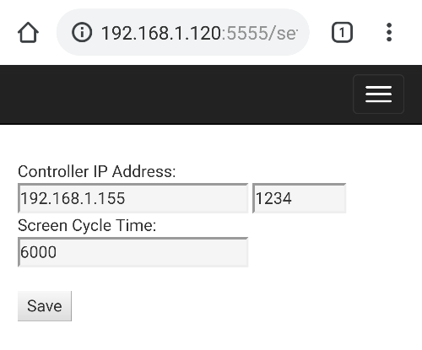
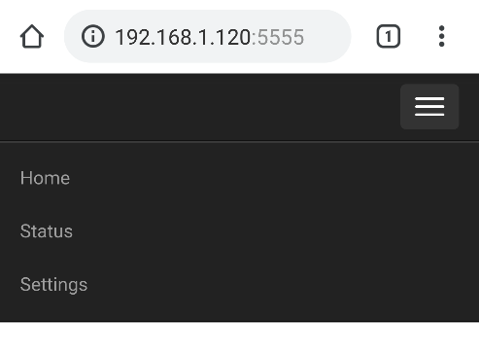
Web Server Software
4/8/2019
ECE554 Embedded Systems
Final Project
36

Slide 37

Testing
Unit Testing
Integration Testing
System Testing
Performance Testing
4/8/2019
ECE554 Embedded Systems
Final Project
37

Slide 38
Test Plan and Cases for Embedded
Unit testing
Individual hardware components – Ensure board is functioning
Each tasks with individual tests for:
Each task state machine
Each function
Reading/writing shared variables
Feeding the Watchdog
Connecting, sending, and receiving network traffic
Integration testing when merging in each task
Timing requirements testing
Functional testing of the embedded system installed
2/4/2019
ECE554 Embedded Systems
Final Project
38

Slide 39
Test Plans
Embedded System Test Plan
# | L | Description | Tests function:
1E | U | Board functional | Basic I/O, IDE, toolchain
2E | U | Display | LCD Driver, Text, Display Task
3E | U | A/D sensing | AD conversion, scaling
4E | U | CO | CO sensor, Calibration
5E | U | Temperature | Temperature, Calibration
6E | U | Relay | Relay module, I/O driver
7E | U | Limit Switches | Switch input
8E | U | Buttons | Button input
9E | U | Network | Associate, receive, send UDP
10E | U | Alarm Logic | State machine for Alarm control
11E | U | Light Logic | State machine for Light control
12E | U | Door Logic | State machine for Door control
13E | U | FreeRTOS | Scheduler, library compatibility
14E | U | Shared Memory | Globals, mutexes, semaphores
15E | I | Network Cmds | Send/Receive commands
16E | I | Display | Integrate all display elements
17E | F | Benchtop Sim | System performance on bench
18E | F | Functional | System performance installed
19E | A | Timing | System response time
Web System Test Plan
# | L | Description | Tests function:
1W | U | Flask | Flask framework
2W | U | SocketIO | SocketIO interactivity
3W | U | Database | Save/Retrieve data
4W | U | Network | Receive/Send UDP
5W | I | Settings Page | Settings functions
6W | I | Status Page | Status page
7W | I | Network Commands | Send/Receive commands
8W | I | Embedded | Embedded send/receive
9W | F | Functional | System performance installed

Slide 40
Embedded Testing
Unit tests were built to execute specific hardware
Tests performed at the completion of each feature
Component testing with dummy data
Simulators used to supply test network data
Checklists and tables used to track integration progress
Integration Testing
Software then merged into the trunk
Periodic regression testing performed during integration
Periodic testing between stable releases of web and embedded
4/8/2019
ECE554 Embedded Systems
Final Project
40

Slide 41
Networked Unit Testing
Unit tests are created for both the ESP32 controller and Raspberry Pi server
ESP32
Tests for UDP message integrity (sending and receiving)
Tests for UDP timing
Tests for Wi-Fi connection and re-connection
Web Server
Tests for UDP message integrity (sending and receiving)
Tests for UDP timing
Tests for HTTP communications
Tests for asynchronous WebSocket behavior and responsiveness
4/8/2019
ECE554 Embedded Systems
Final Project
41

Slide 42
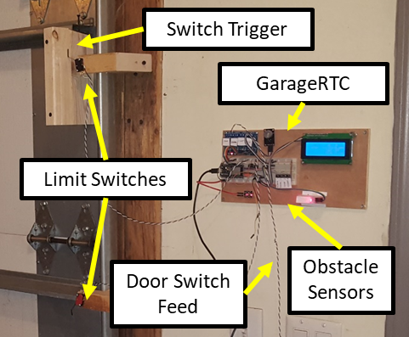
Acceptance Test Installation

Slide 43
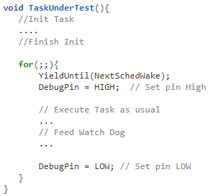
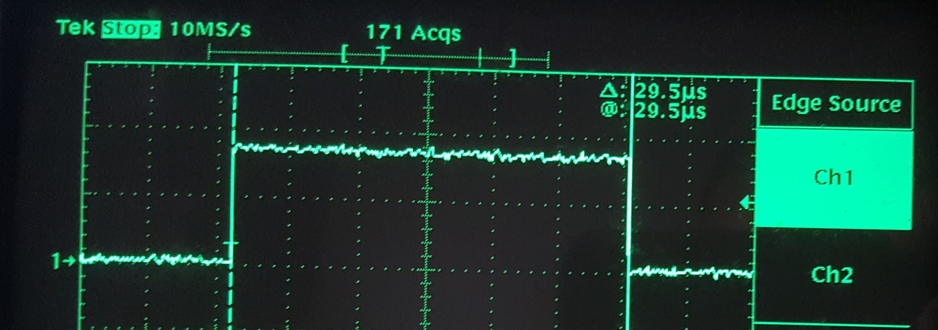
Non-preempted Timing
For each test
All other tasks disabled
Debug port attached to an oscilloscope
Debug pin set high on task wake-up
Set low after last instruction
Captured timing on scope – Best possible timing
Captured Non-preempted Timing for the TaskReadSensors – 29.5uS
Pseudo code used for unprempted task timing
4/8/2019
ECE554 Embedded Systems
Final Project
43

Slide 44
Non-preempted Timing
The non-preempted timing was recorded for each task
The cycle timing for scheduler was also captured
Cycle times were found to be exceptionally accurate
Display task was found to be stand out slow
Research revealed lots of delays in the I2C library
Most likely to make the library compatible with wide variety of displays
Task | Function | Priority | Freq | F Meas | t
TaskReadSensors | Reading and converting sensor input | High | 100 Hz | 100 Hz | 29.5 uS
TaskStateMachines | Door, Alarm, and Light Control | High | 10 Hz | 10 Hz | 1.41 uS
TaskNetwork | Network | Low | 1 Hz | 1 Hz | 1.015 – 2.015 mS
TaskUpdateDisplay | Display | Low | 2 Hz | 2 Hz | 39 mS
TaskIdle | WatchDog Collection | Low | 0.7 Hz | Varies | 1.05 uS
4/8/2019
ECE554 Embedded Systems
Final Project
44

Slide 45
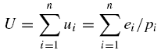
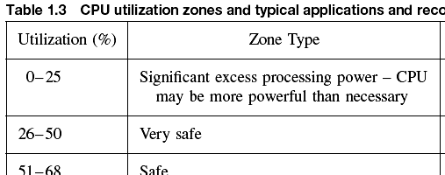
Utilization Calculation
Calculated worst case utilization
U = 8.3% - Extremely underutilized
Overpowered but ESP32 has other benefits!
Task | F Meas | e_{i} | p_{i} | e_{i}/p_{i}
TaskReadSensors | 100 Hz | 29.5 uS | 0.01 | 0.00295
TaskStateMachines | 10 Hz | 1.41 uS | 0.1 | 1.41E-05
TaskNetwork | 1 Hz | 2.015 mS | 1 | 0.002015
TaskUpdateDisplay | 2 Hz | 39 mS | 0.5 | 0.078
TaskIdle | Varies | 1.05 uS | 0.666667 | 1.58E-06
 |  |  | Total: | U = 0.083
4/8/2019
ECE554 Embedded Systems
Final Project
45

Slide 46
Flash and Memory
Current application uses 720 kB bytes (54%) of program memory 1.31 MB
Without Networking and UDP libraries, application consumed ~15%
Network stack and UDP messaging consumes ~524 kB
Almost 40% of program memory!
Global variables use 38kB (11%) of dynamic memory
290 kB for local variables
Includes individual task stacks
4/8/2019
ECE554 Embedded Systems
Final Project
46

Slide 47
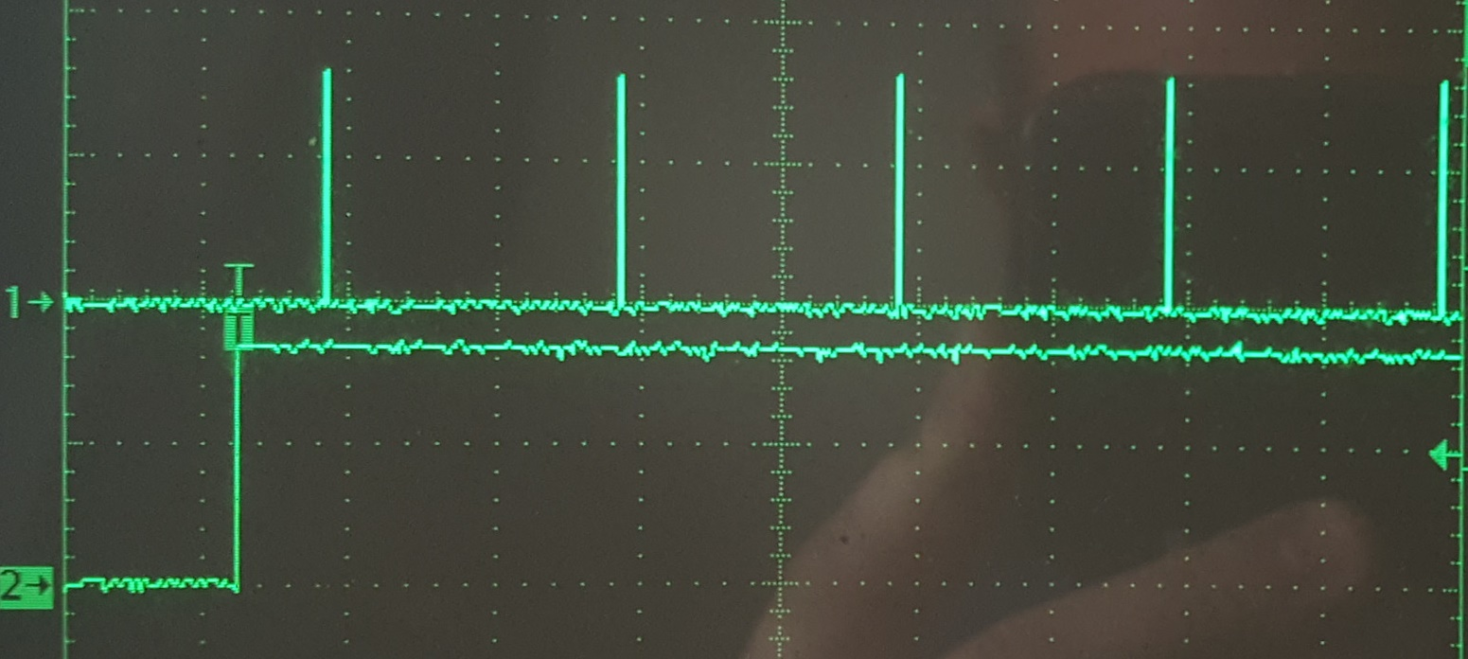
Concurrent Execution Timing
All tasks were returned to active scheduling
Added second scope channel to ensure task priority was being enforced
Timing remeasured with preemption and compared
Channel 1 - TaskReadSensors
Channel 2 – TaskUpdateDisplay
The scheduler is stealing time from the longer TaskUpdateDisplay to ensure TaskReadSensors is executed on schedule.
4/8/2019
ECE554 Embedded Systems
Final Project
47

Slide 48
Preempted Timing
The following table shows the preempted timing
Of particular note
Display timing got much worse ~ 6x slower
Most others stayed about the same
Further investigation on the display task is required
Task | Function | Priority | Freq | F Meas | t w/o PE | T with PE
TaskReadSensors | Reading and converting sensor input | High | 100 Hz | 100 Hz | 29.5 uS | 29.5 uS
TaskStateMachines | Door, Alarm, and Light Control | High | 10 Hz | 10 Hz | 1.41 uS | 1.38 uS
TaskNetwork | Network | Low | 2 Hz | 2 Hz | 1.015 – 2.015 mS | 2.02 mS
TaskUpdateDisplay | Display | Low | 2 Hz | 2 Hz | 39 mS | 274 mS
TaskIdle | WatchDog Collection | Low | 0.7 Hz | Varies | 1.05 uS | 1.05uS
4/8/2019
ECE554 Embedded Systems
Final Project
48

Slide 49
Response Timing
Timing measured using oscilloscope
CH1 Connected to button input, CH2 to relay output
Measured 10 transitions, and averaged. Max was no more than 86.2, average 58.6
Web timing and display timing based on cycle times.
All timing requirements per original proposal met
Parameter | Timing Requirement | Measurement | P/F
Local Display | Every 500 ms or better | 500 ms | P
Obstacle Detection | Toggle opener within 150 ms from detection | < 86.2 ms | P
Limit Switch | Toggle opener within 150 ms from detection | < 86.2 ms | P
Door movement | Toggle opener within 300 ms from press | < 86.2 ms | P
Light | Latch light within 300 ms from press | < 86.2 ms | P
Idle Post to Server | Post to the server every 5000 ms | 500 ms | P
Event push to server | Post to the server within 500 ms from event. | <= 500 ms | P
Check Server | Check remote messages every 1000 ms | 500 ms | P
4/8/2019
ECE554 Embedded Systems
Final Project
49

Slide 50
Comparison with other Products
Performed market survey
Chamberlain MYQ-G0301
Aladdin Connect
Garage Door Buddy
Go Control GD00z-4
Generated Matrix for comparison
Considered
Connectivity
Digital Assistant Compatibility
Sensing and Control
Local Control Features
Openness of Design

Slide 51
Comparison with other Products
Feature | MYQ-G301 | Connect | Door Buddy | GoControl | GarageRTC
Connectivity
WiFi | ✔ | ✔ | ✔ |  | ✔
Bluetooth |  |  |  |  | 1
ZWave |  |  |  | ✔
Digital Assistant
Alexa |  |  |  |  | 2
Google |  |  |  |  | 3
Siri |  |  |  |  | 3
Sense/Control
Aux Control | 4 |  |  |  | ✔
Amb. Temp |  |  |  |  | ✔
Amb. CO |  |  |  |  | ✔
Door Position | ✔ | ✔ | ✔ | ✔ | ✔
Local Control
LCD Display |  |  |  |  | ✔
Door | ✔ | ✔ | ✔ | ✔ | ✔
Aux/Light |  |  |  |  | ✔
Open Source
Web App |  |  |  |  | ✔
FOSS |  |  |  |  | ✔
Published API |  |  |  |  | ✔
HW Schematic |  |  |  |  | ✔
Universal |  |  | ✔ | ✔ | ✔

Slide 52
Comparison with other Products
Findings:
GarageRTC mostly comparable with similar products
Open Source means could extend to include missing features
Security not considered
Most other products claimed security
Not forthcoming with mechanism or implementation
Other researchers had found problems with their security [6] [7]
Omitted since offering unknown quality of security could not be compared
Open source could help here
Open publishing of security mechanisms could lead to community improvements
Security through obscurity is not viable solution
4/8/2019
ECE554 Embedded Systems
Final Project
52

Slide 53
Accomplishments
Embedded Hardware Development:
System is assembled and complete
Individual hardware tests pass
Test system is reliable and consistent
Embedded Software Development:
Embedded system development is mostly complete
Web connectivity needs integration
Web Software Development:
Web receiver/transmitter are working with simulators
Completed interface and integration
Testing
Embedded system has completed unit and integration tests
Timing testing is nearly complete
Hardware installation for functional tests
4/8/2019
ECE554 Embedded Systems
Final Project
53

Slide 54
Closing Remarks
It was a challenge to integrate the IoT and embedded elements
All materials in GitHub project: https://github.com/jharmer95/Garage-RTC
ESP32 performance far exceeds system requirements but:
Integrated Wi-Fi makes connectivity possible
Exceptional library support made integration faster
FreeRTOS support made multitasking easier
Possible Future Improvements:
H-Bridge motor drive for direct door control
Encryption between controller and server
Develop Android application with notification support
Add Built-In-Test (BIT)
Front panel guided menus for set-points, settings, AUX control
Support for viewing CCTV feed connected to web server
4/8/2019
ECE554 Embedded Systems
Final Project
54

Slide 55
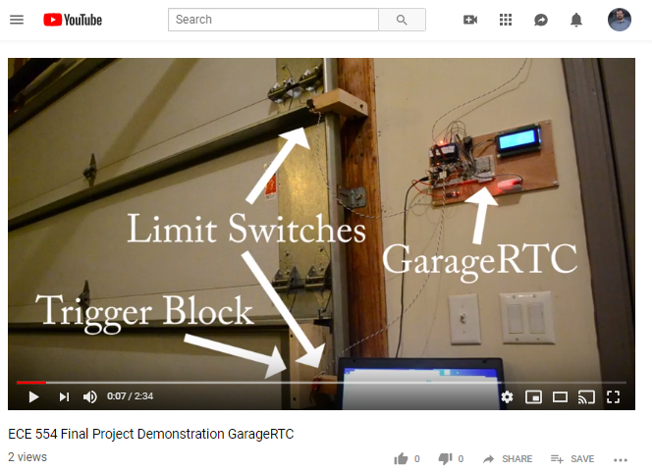
Video
On YouTube Here: https://www.youtube.com/watch?v=IwsxoqProoo
4/8/2019
ECE554 Embedded Systems
Final Project
55

Slide 56
References
[1] Explore Embedded, "Overview of ESP32 features. What do they practically mean?," Explore Embedded, 8 April 2019. [Online]. Available: https://www.exploreembedded.com/wiki/Overview_of_ESP32_features._What_do_they_practically_mean%3F.
[2] Amazon Web Services (AWS), "FreeRTOS - Why Use an RTOS Kernel?," Amazon Web Services (AWS), 8 April 2019. [Online]. Available: https://www.freertos.org/tutorial/solution1.html.
[3] Rapita Systems, "What are “co-operative” and “pre-emptive” scheduling algorithms?," Rapita Systems, 2019 April 2019. [Online]. Available: https://www.rapitasystems.com/blog/cooperative-and-preemptive-scheduling-algorithms.
[4] I. V. Cretu, V. M. Micea and S. C. Stangaciu, "Hard real-time execution environment extension for FreeRTOS," in IEEE International Symposium on Robotic and Sensors Environments (ROSE), Timisoara, Romania, 2014.
[5] Amazon Web Services (AWS), "FreeRTOS Project," Amazon Web Services (AWS), 8 April 2019. [Online]. [Accessed 2019].
[6] Margulies, "Garage Door Openers: An Internet of Things Case Study," IEEE Security & Privacy, 2015.
[7] C. Goudie and R. Weidner, "Home hackers: Digital invaders a threat to your house," ABC 7 News, Chicago IL, 12 February 2015.
4/8/2019
ECE554 Embedded Systems
Final Project
56

Slide 57
Questions?
Daniel A. Zajac
danzajac@umich.edu
(313) 655-7533
Jackson Harmer
jharmer@umich.edu
(810) 941-2280
4/8/2019
ECE554 Embedded Systems
Final Project
57

